Slide 1
Sequence Mining

Slide 2
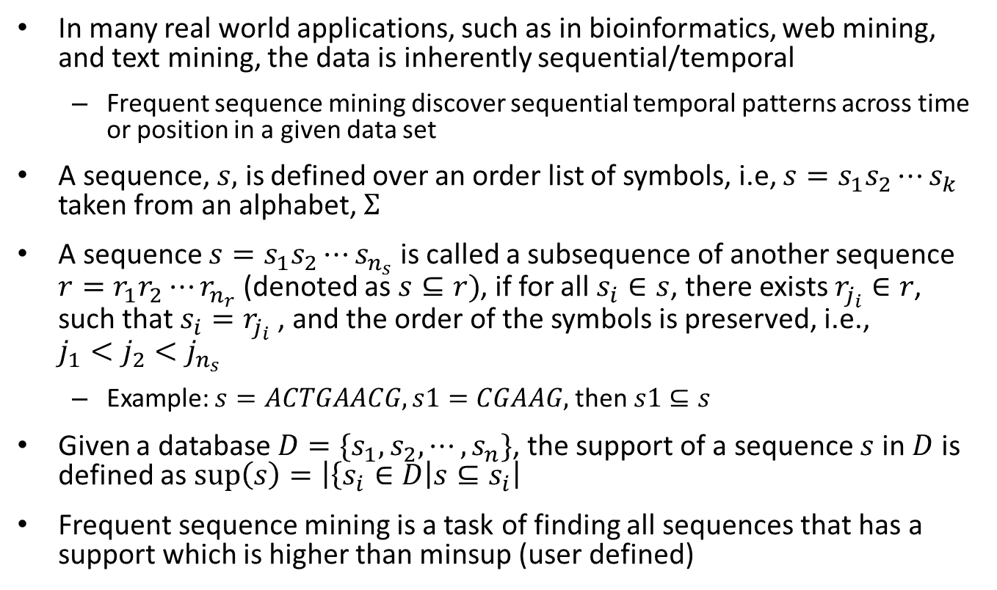
Introduction
In many real world applications, such as in bioinformatics, web mining, and text mining, the data is inherently sequential/temporal
Frequent sequence mining discover sequential temporal patterns across time or position in a given data set
A sequence, $s,$ is defined over an order list of symbols, i.e, $s=s_{1}s_{2}⋯s_{k}$ taken from an alphabet, $Σ$
A sequence $s=s_{1}s_{2}⋯s_{n_{s}}$ is called a subsequence of another sequence $r=r_{1}r_{2}⋯r_{n_{r}}$ (denoted as $s⊆r)$, if for all $s_{i}∈s$, there exists $r_{j_{i}}∈r$, such that $s_{i}=r_{j_{i}}$, and the order of the symbols is preserved, i.e., $j_{1}<j_{2}<j_{n_{s}}$
Example: $s=ACTGAACG, s1=CGAAG,$then $s1⊆s$
Given a database $D=\{s_{1}, s_{2}, ⋯, s_{n}\}$, the support of a sequence $s$ in $D$ is defined as $\sup\left(s\right)=\left|\left\{s_{i}∈D\right|s⊆s_{i}\right|$
Frequent sequence mining is a task of finding all sequences that has a support which is higher than minsup (user defined)

Slide 3
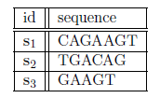
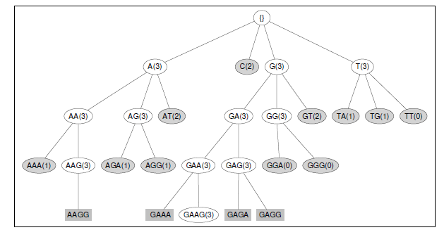
Sequence Mining
Sequence Database
Sequence mining with a support =3

Slide 4
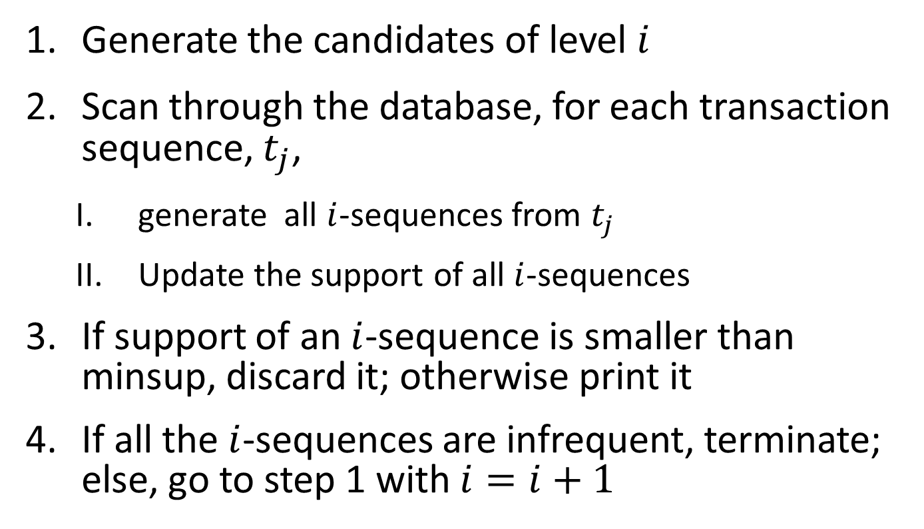
Level-wise mining
Generate the candidates of level $i$
Scan through the database, for each transaction sequence, $t_{j}$,
generate all $i$-sequences from $t_{j}$
Update the support of all $i$-sequences
If support of an $i$-sequence is smaller than minsup, discard it; otherwise print it
If all the $i$-sequences are infrequent, terminate; else, go to step 1 with $i=i+1$

Slide 5
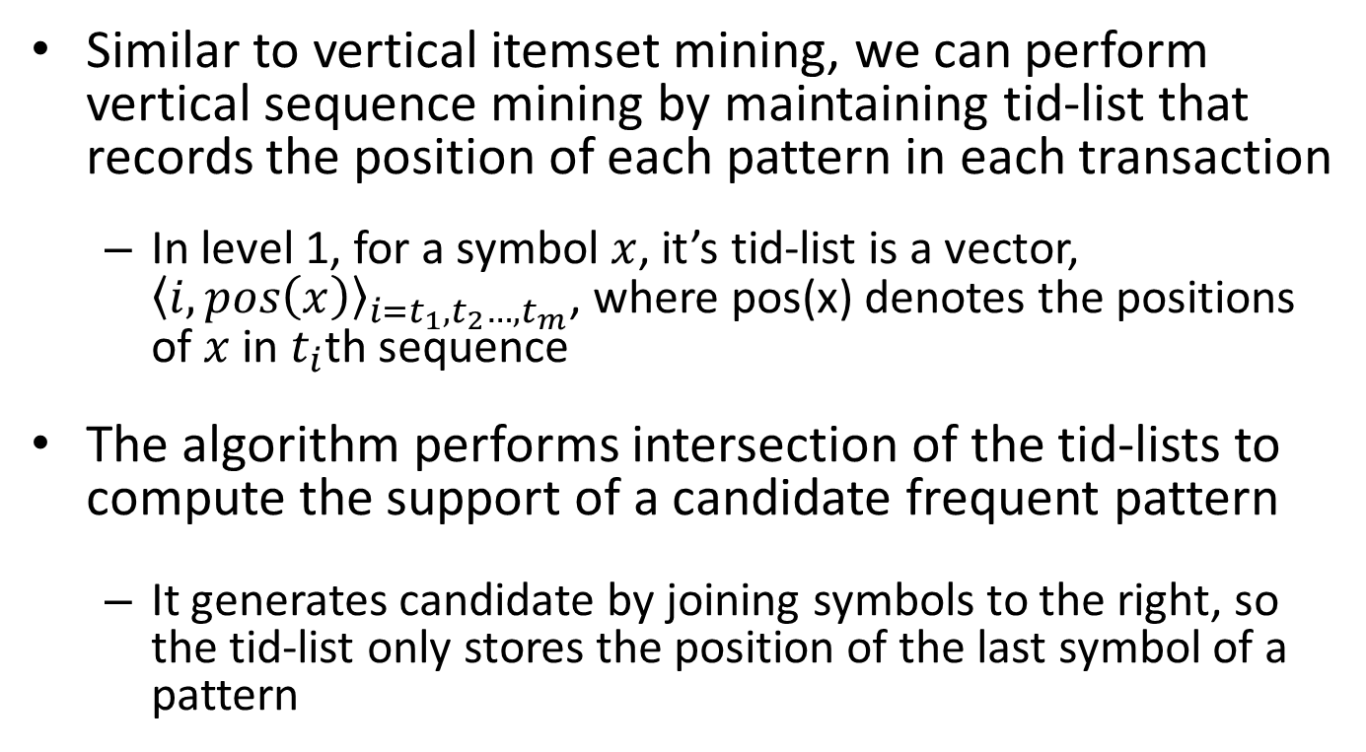
Vertical Sequence Mining
Similar to vertical itemset mining, we can perform vertical sequence mining by maintaining tid-list that records the position of each pattern in each transaction
In level 1, for a symbol $x$, it’s tid-list is a vector, ${〈i, pos\left(x\right)〉}_{i=t_{1},t_{2}…, t_{m}}$, where pos(x) denotes the positions of $x$ in $t_{i}$th sequence
The algorithm performs intersection of the tid-lists to compute the support of a candidate frequent pattern
It generates candidate by joining symbols to the right, so the tid-list only stores the position of the last symbol of a pattern

Slide 6
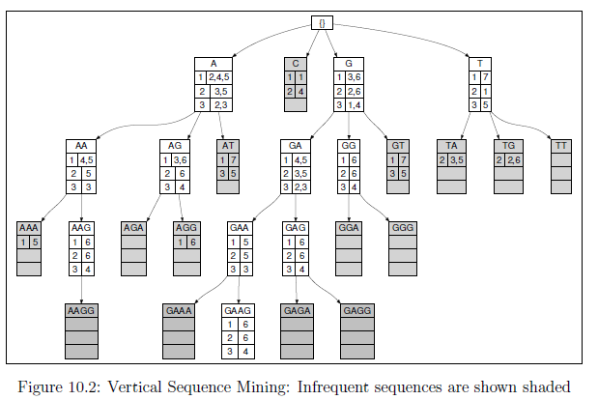
Vertical sequence mining (example)

Slide 7
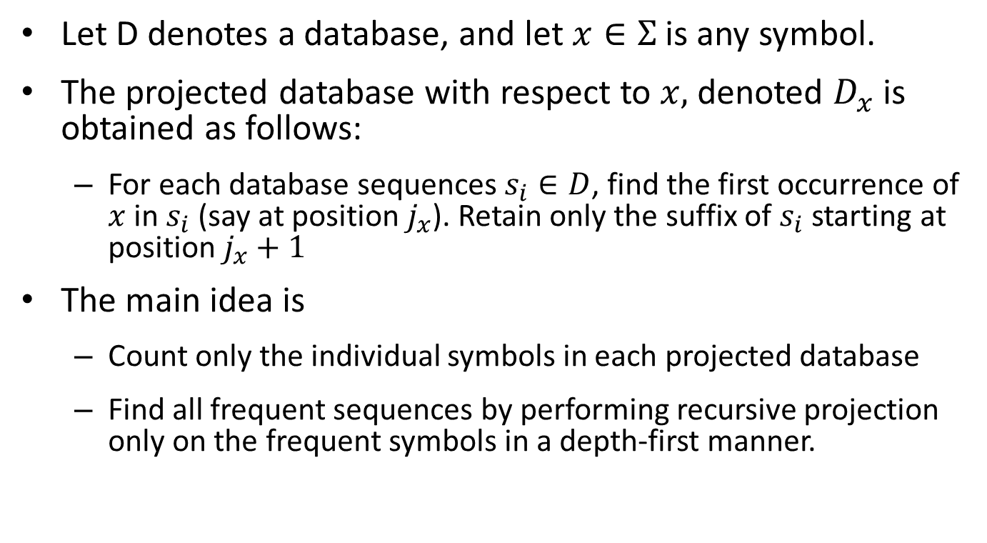
Projection-based sequence Mining
Let D denotes a database, and let $x∈Σ$ is any symbol.
The projected database with respect to $x,$ denoted $D_{x}$ is obtained as follows:
For each database sequences $s_{i}∈D$, find the first occurrence of $x$in $s_{i}$ (say at position $j_{x}$). Retain only the suffix of $s_{i}$ starting at position $j_{x}+1$
The main idea is
Count only the individual symbols in each projected database
Find all frequent sequences by performing recursive projection only on the frequent symbols in a depth-first manner.

Slide 8
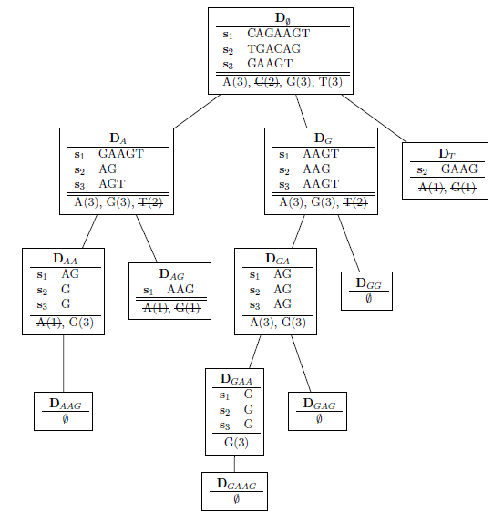
Projection based sequence mining (example)

